Slide 1



Exceptions and Limitations
Copyright in the Digital Environment
Amy Thomas
4 February 2026

Slide 2
Format: 4 February
Limitations (duration and insubstantial parts)
Exceptions (whole work and fair dealing)
Assignment notes: Formative and summative assessment questions are now available on the Moodle

Slide 3
Work falls within copyrightable subject-matter + fixed permanently + meets the originality standard = copyright
Copyright = Economic and moral rights
… But copyright is not an ‘absolute’ right and includes many:
Limitations (spaces where copyright doesn’t exist)
Exceptions (instances where infringement doesn’t exist)

Slide 4
Limitations
Idea-expression dichotomy (see Seminar 2 materials)
(Open) licensing
Duration of rights
Insubstantial parts of works
We’ll focus on these today

Slide 5
Limitation: Duration of rights
Written, dramatic, musical and artistic work -> 70 years after the author’s death
Sound and music recording -> 70 years from when it’s first published
Films -> 70 years after the death of the director, screenplay author and composer
Broadcasts -> 50 years from when it’s first broadcast
Layout of published editions of written, dramatic or musical works -> 25 years from when it’s first published
Joint authorship: calculated from the date of the death of the last living author
Company copyright: calculated from the death of the author
After copyright expires, works enter the public domain

Slide 6
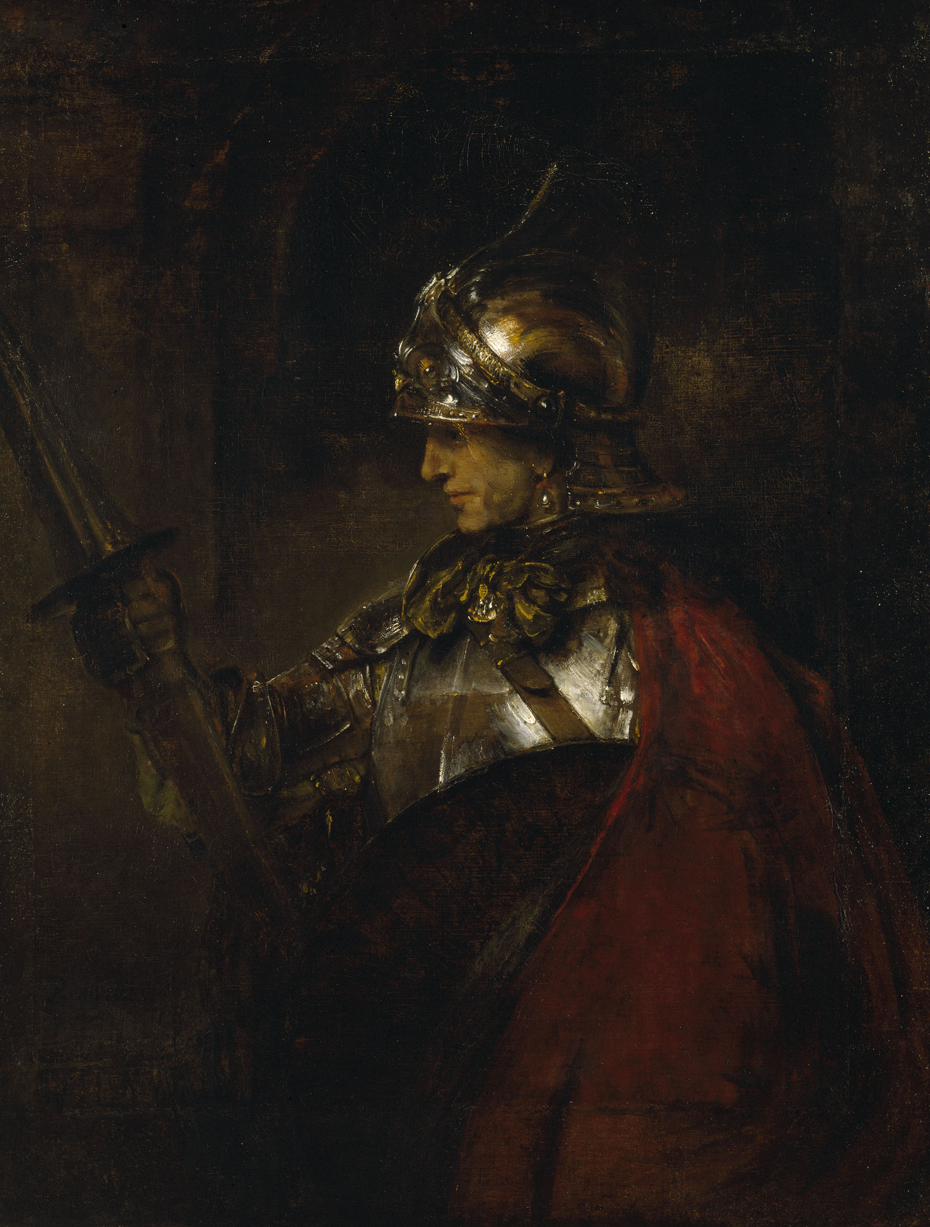
Limitation: Duration of rights
You find this picture of Rembrandt’s ‘A Man in Armour’ (1655) in a Google Image search.
Are you allowed to copy this picture and sell it on posters on Etsy?
Would your answer change if you were the person taking the picture (rather than copying someone else’s from Google)?
Image source

Slide 7
Limitation: Duration of rights
1. Original adaptations of public domain works will often attract new copyright in themselves (e.g. Romeo + Juliet)
2. Copyright is territorial: public domain works in the UK might not be public domain elsewhere (see e.g. the case of Anne Frank’s diary)

Slide 8
Limitation: Substantial part
s.16(2) and (3) CDPA: ‘Copyright in a work is infringed by a person who without the licence of the copyright owner does, or authorizes another to do, any of the acts restricted by the copyright.’
[…] (a) in relation to the work as a whole or any substantial part of it.
Remember, this is a qualitative rather than quantitative assessment: not a question of percentages/fractions of a work
England and Wales Cricket Board v Tixdaq [2016] EWHC 575 (Ch) :
"[q]uantitatively, 8 seconds is not a large proportion of a broadcast or film lasting two hours or more. Qualitatively, however, it is clear that most of the clips uploaded constituted highlights of the matches […] Thus most of clips showed something of interest, and hence value […] Accordingly ... each such clip constituted a substantial part of the relevant copyright work(s)."

Slide 9
Exceptions: Legal framework
Berne ‘three step’ test Art 9(2)
‘It shall be a matter for legislation in the countries of the Union to permit the reproduction of such works in (1) certain special cases, provided that such reproduction (2) does not conflict with a normal exploitation of the work and does not (3) unreasonably prejudice the legitimate interests of the author.
EU influence: InfoSoc Directive (2001) Art 5
Exhaustive and optional list of exceptions
Exceptions are not harmonized at EU level
Only mandatory exception is transient or incidental copying as part of a network transmission or legal use (Art 5.1)
National implementation: CDPA 1988 Chapter 3
Some exceptions cannot be overridden by contract law

Slide 10
Exceptions: ‘Whole work’ exceptions
Necessary, temporary copies (Art 5.1. InfoSoc) (remember FAPL v Karen Murphy)
Text and data mining (CDPA s29A) – more on this in Seminar 8
Incidental inclusion (CDPA s31)
Education (CDPA s34)
Accessible copies (CDPA s31A-31F)
Freedom of panorama (CDPA s62)
Preservation of a work (s40A – 43A)

Slide 11

Exceptions: Private copying
Does the UK have an exception that allows people to copy works for purely private purposes? e.g., to use a picture as the background on your phone, to back up your expensive software etc.
https://forms.cloud.microsoft/e/ZHkNj6KziU

Slide 12
Exceptions: ‘Fair dealing’ exceptions
Illustration for instruction (CDPA s32)
Research and private study (CDPA s29)
Criticism and review (CDPA s30(1))
Caricature, parody and pastiche (CDPA s30A)
Quotation (CDPA s30(1ZA)
We’ll focus on these today

Slide 13
What is ‘fair dealing’?
Some exceptions only apply when there is ‘fair dealing’ with the work
No statutory definition of ‘fair’: case-to-case basis based on degree and impression
Would a ”fair minded and honest person” regard the dealing as fair? Hyde Park v Yelland
Suggested factors:
The extent of what has been used;
The amount and importance of the work taken;
The proportion of what has been used in relation to the rest of the work or the commentary;
Dishonest acquisition of the work;
Excessive use in relation to the purpose;
Commercially competing with the claimant’s work.

Slide 14
What is ‘fair use’?
US version of exceptions system
A defence (excused infringement) not an exception
Not limited in purpose, non-exhaustive list of applications
Broader, multifactorial test (e.g., is the use ‘transformative’)
Wider scope, but also more subjective (difficult to predict)
Main difference is that fair dealing (UK) is limited to purpose and form – new uses/technologies must be able to fit into an existing category or it is de facto infringement.

Slide 15
Exception: Quotation for criticism and review
S30(1) CDPA requirements:
1) The purpose is really for criticism or review
2) The material used is available to the public
3) The use of the material is fair
4) Where practical, the use is accompanied by a sufficient acknowledgement
e.g. to support the merit or particulars of a work, morals or philosophy, social implications etc.
Pelham GmbH and Others v Ralf Hütter: quotation should be ‘‘for the purposes of illustrating an assertion, of defending an opinion or of allowing an intellectual comparison between that work and the assertions of that user’
Speigel v Beck: need to demonstrate a direct and close link between the quoted work and your reflections

Slide 16

Exception: Quotation for criticism and review
Time Warner Entertainments Company LP v Channel Four Television Corporation [2004]
The documentary (about the decision to withdraw A Clockwork Orange in UK) contained 12 clips of between 10 seconds and 115 seconds and in aggregate to 12½ mins (8 per cent of the film and about 40 per cent of the programme)
The more you engage with the content, the easier is to benefit from the exception.

Slide 17
Exception: Parody, caricature and pastiche
s30A CDPA requirements:
1) Fair dealing with a work for the purposes of caricature, parody or pastiche does not infringe copyright in the work.
2) To the extent that a term of a contract purports to prevent or restrict the doing of any act which, by virtue of this section, would not infringe copyright, that term is unenforceable.
Parody: new creative work which uses an existing work for humour or mockery
Caricature: something that portrays subject in a simplified or exaggerated manner
Pastiche: imitation of the style of another artist

Slide 18

Exception: Parody, caricature and pastiche
Deckmyn and Vrijheidsfonds v. Vandersteen (2014), essential characteristics of a parody:
to evoke an existing work while being noticeably different from it, and
to constitute an expression of humour or mockery.
Image Source

Slide 19
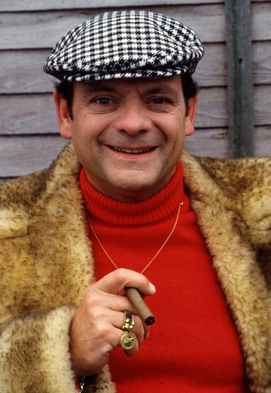
Exception: Parody, caricature and pastiche
‘… mere imitation (of a work of comedy) is not enough to constitute parody.’ (at 180)
(a) … Rather it takes the characters, with their full back story and catch phrases and simply (re)presents them in a live dining format.
(b) The use made of Del Boy and the other characters, their language, jokes and backstories from OFAH in the setting of an imaginary pub quiz involves a wholesale borrowing of content. It is close to reproduction by adaptation than pastiche.
Image Source

Slide 20
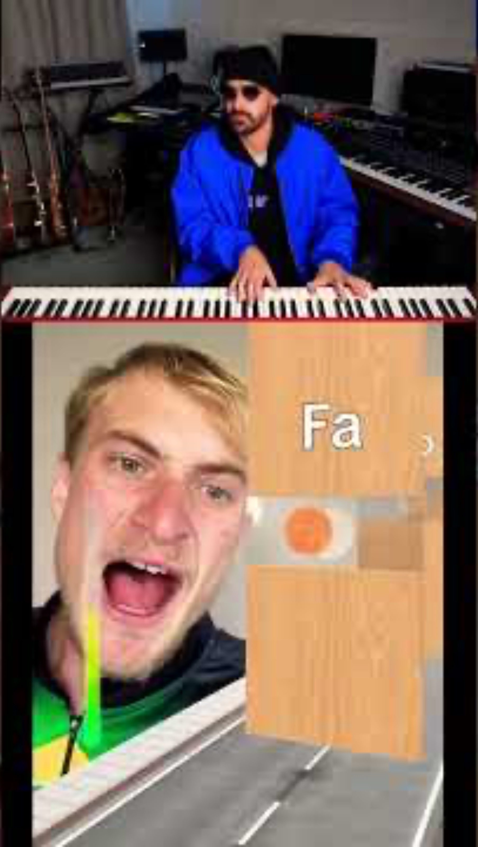

Exception: Parody, caricature and pastiche
Assume the original creator (the singer) is unhappy with how their video has been used by the musician/pianist. What would you advise them and why?
Note: this is today’s participation activity

Slide 21
Exceptions: A summary
Does the use fall into one of the listed exceptions/purpose? + (if a fair dealing exception) is it fair (multifactorial test)?

Slide 22
Next week…
Any questions/concerns, office hours are Wednesdays 1:30 – 2:30 (please email amy.thomas@glasgow.ac.uk)
Readings/preparation for 11 February (Infringement)

